Slide 1
CIS 499 Home Hustler Team: Blake Edens, Waylon Ergle, Mattia Galanti Sponsor: Mr. Paul Cuenin, Marketing Director at Greenwood Partnership Alliance Supervisor: Dr. Farha Ali

Slide 2
Agenda
Problem Statement
Our Solution
Alternatives
System Design
Functionality
Look & Feel
Recap
Questions?

Slide 3
Problem Statement
Popular real estate search engines such as Zillow lack search optimization based on commuting costs.
Commuting costs can add significant drawback to personal finances when considering:
gas consumption
depreciation
maintenance
time loss
On average, each mile of commuting will cost $170 per year.
When factoring in time lost through commuting, the potential loss of on-the-clock pay increases commuting cost substantially.
Factoring in time loss for an employee who earns $25 per hour, each mile of commuting will cost $795 per year

Slide 4
Our Solution
Home Hustler offers a search engine capable of optimizing commute costs for to-be homebuyers, allowing them to find the perfect balance for their budget.

Slide 5
Alternatives
Zillow
Realtor
Trulia
HomeFinder
Remax
Our Solution
Search optimization based on commuting costs

Slide 6
System Design
Use Case Diagram
Class Diagram

Slide 7
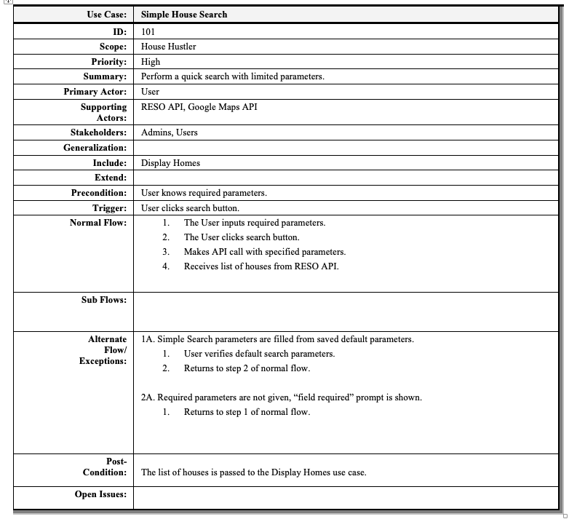

Slide 8
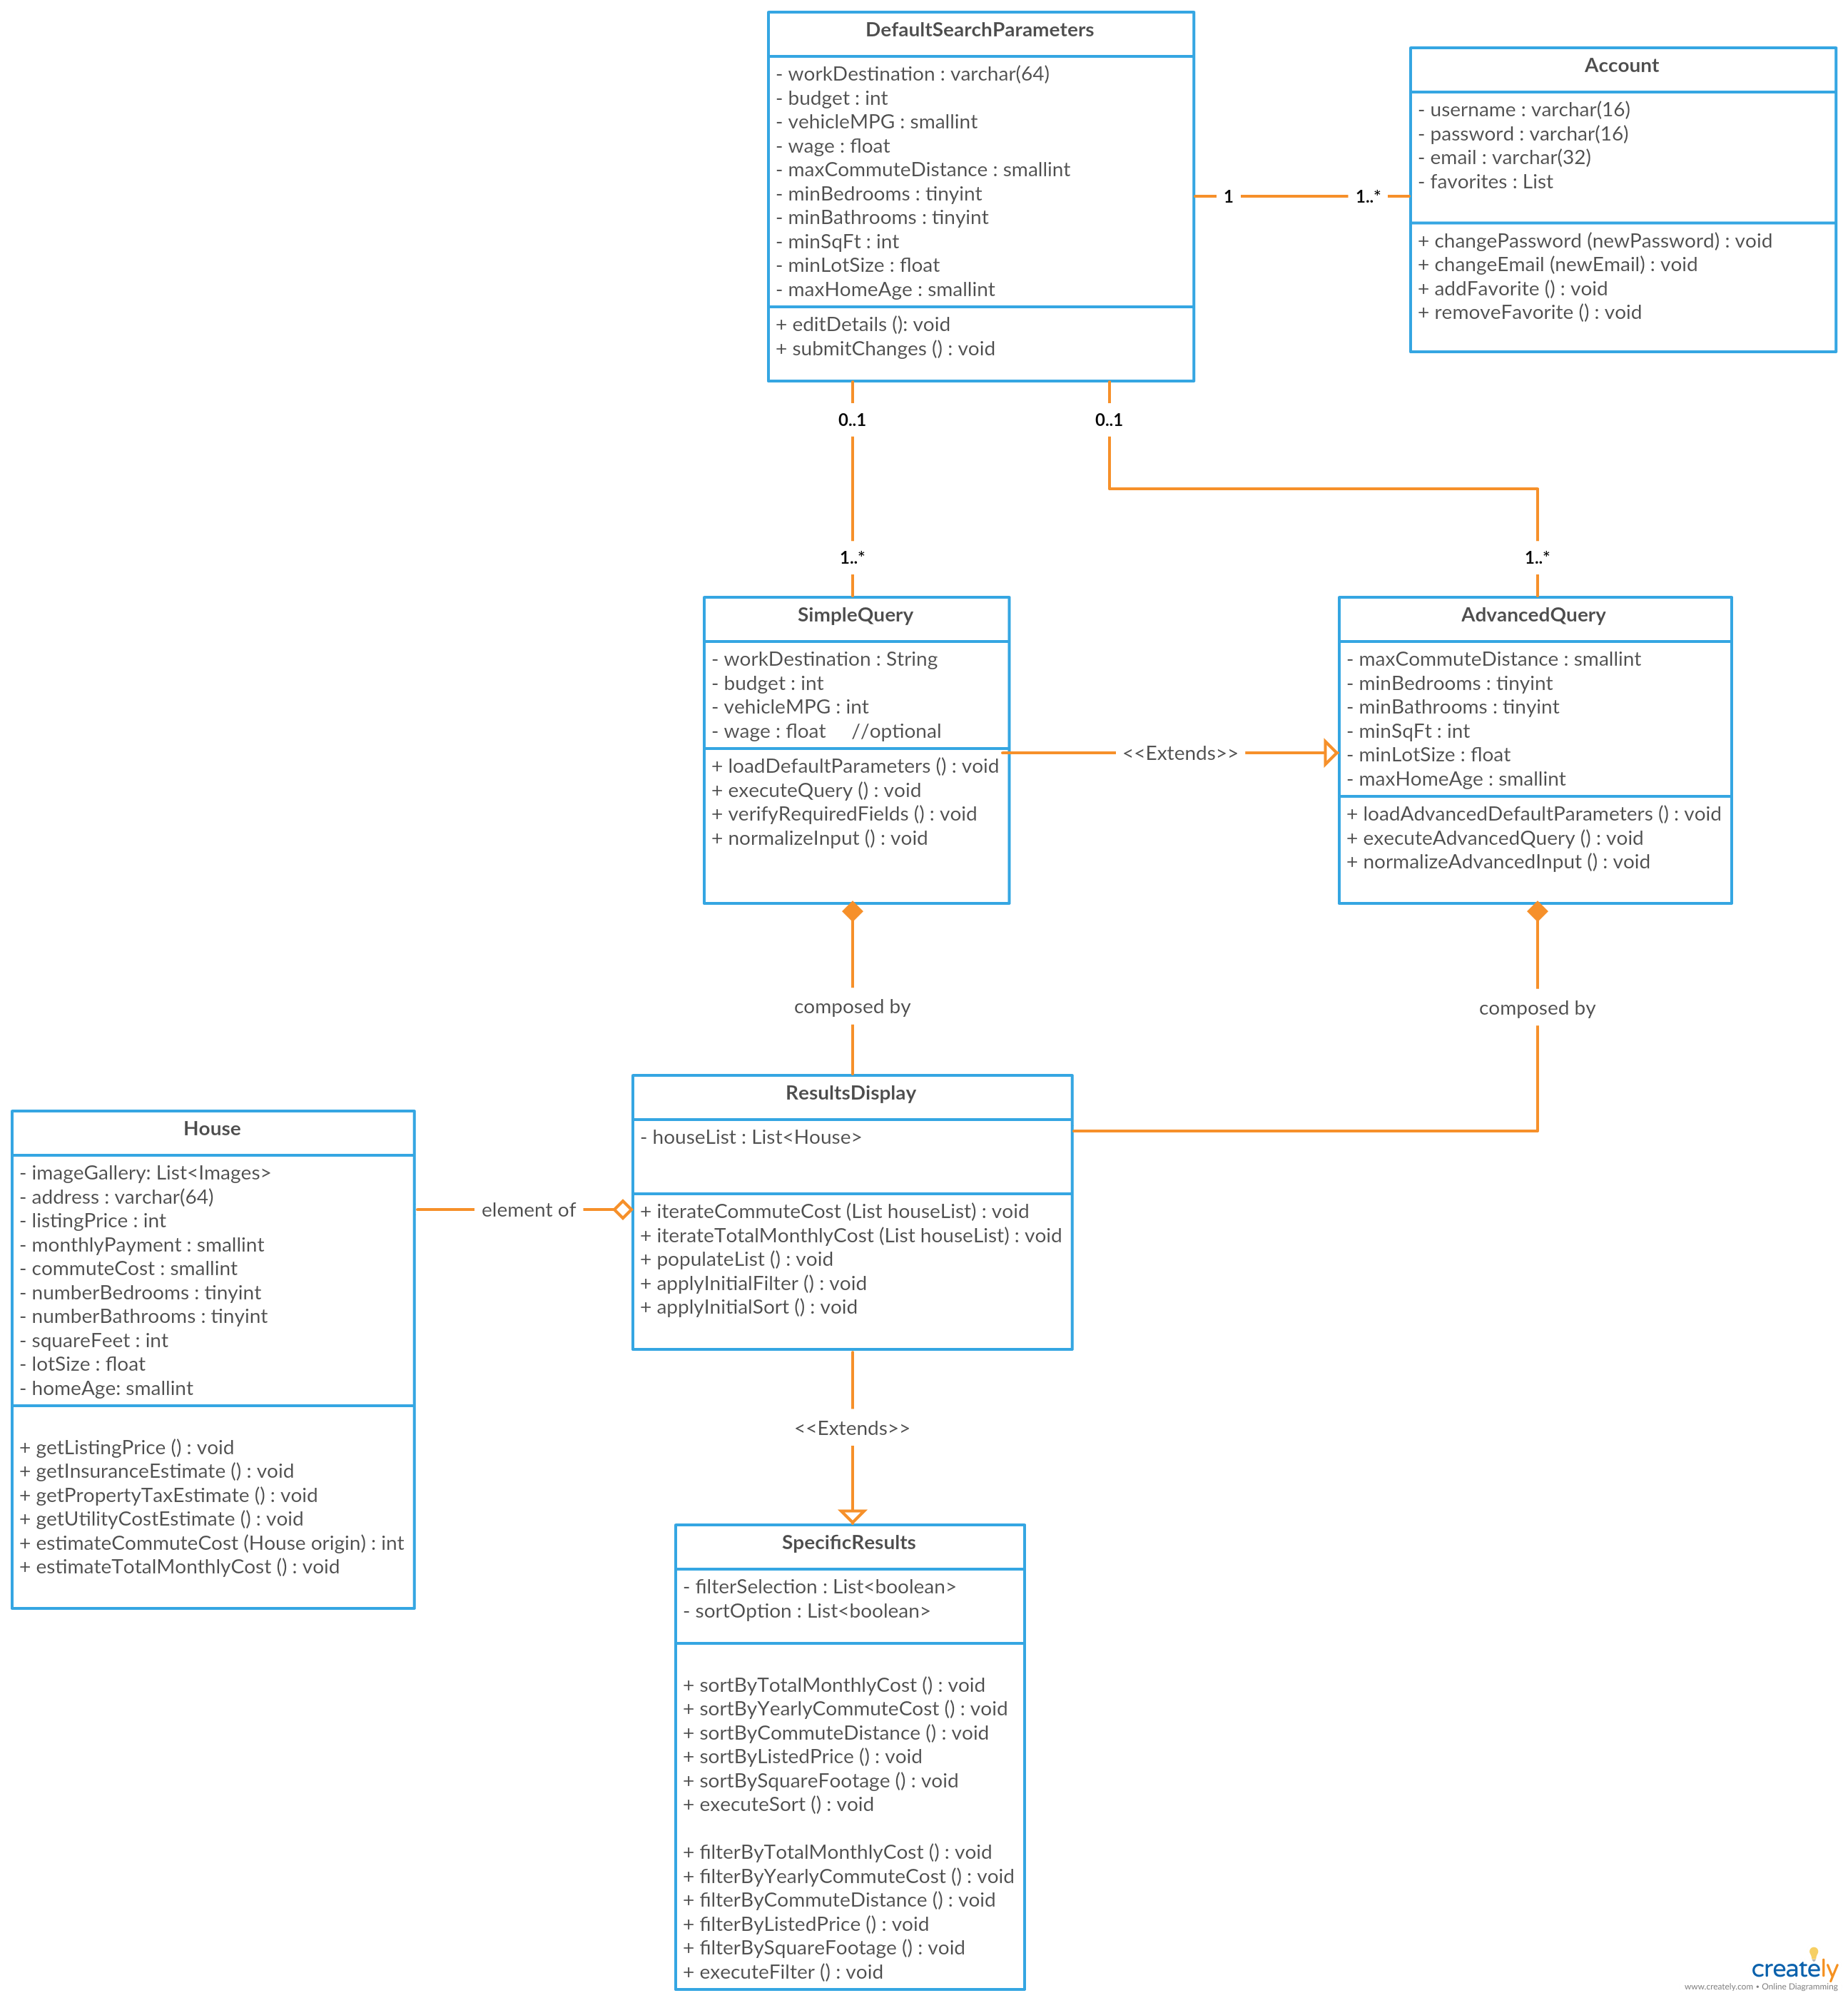

Slide 9
Functionality
Search
By cost
By square footage
By number of bedrooms/bathrooms
By distance from work location
Sort Results
By estimated total yearly/monthly cost
By estimated yearly commute cost
By commute distance
By listed price
Account Management
Creation
Modification
Login
Logout

Slide 10
Look & Feel
http://localhost:8080/home-hustler/

Slide 11
Recap
Designing the website required:
HTML
CSS
SQL
PHP
JavaScript
jQuery
AJAX for Google Maps API calls
RESO API
Google Maps API
Utility API

Slide 12
Thanks!
Any questions?

